Slide 1

Daily Journaling App
Created by Stefan Josevski
4/6/25

Slide 2

Why I chose this and overview
I wanted to create a project that promotes mental wellness and daily self-reflection because I feel like in this world now, that is shadowed away when it should be a main focus.
Journaling is a personal hobby of mine- it helps me stay focused, express my thoughts and how I am feeling, and track my personal growth
The purpose of my project is to create a digital Journaling Tool with entries, reminders, tags, and export features.
I used Java, JavaFX, and object-oriented programming, utilizing the skills I learned from the lecture.

Slide 3

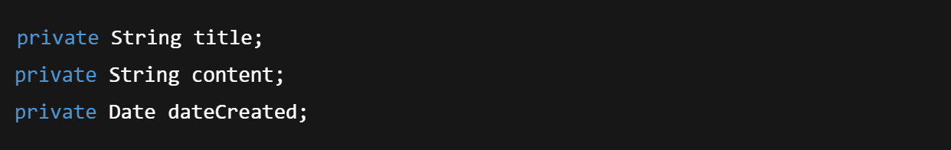
Data and Expressions
We learned in this chapter concepts like variables, data types, and expressions
Here is an example from my code
This uses String, int, and Date
ID tracking using static counters
Expressions for ID generation: entryID = nextId++;

Slide 4

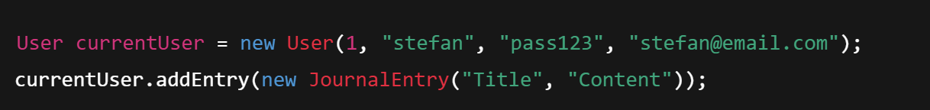
Using Classes and Objects
Some concepts in this chapter are Object instantiation, method calls
Here is an example of this in my code:
This shows how objects like User, JournalEntry are used and work in my code
Method calls to modify the object state.

Slide 5

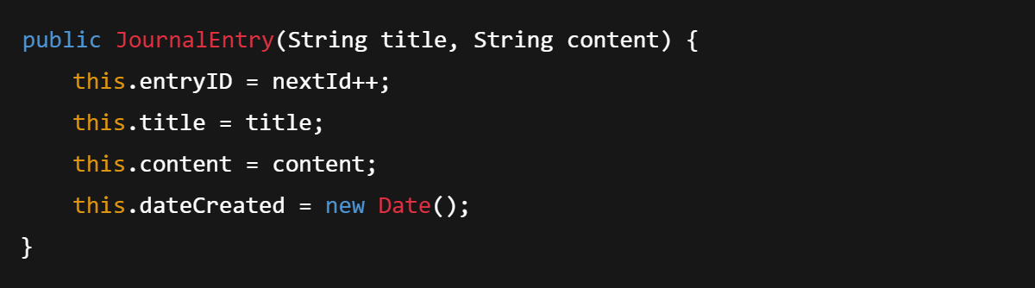
Writing Classes
This chapter consisted of Constructors and encapsulation
Here it is embedded in my source code:
This constructor sets fields
Fields are private to maintain encapsulation.

Slide 6
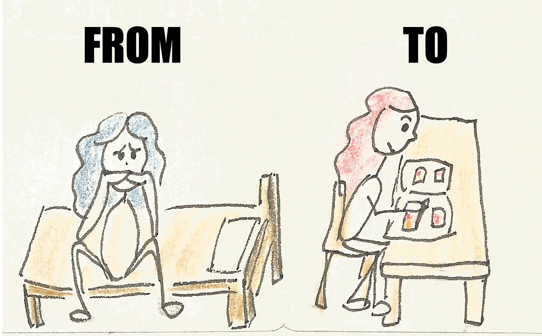
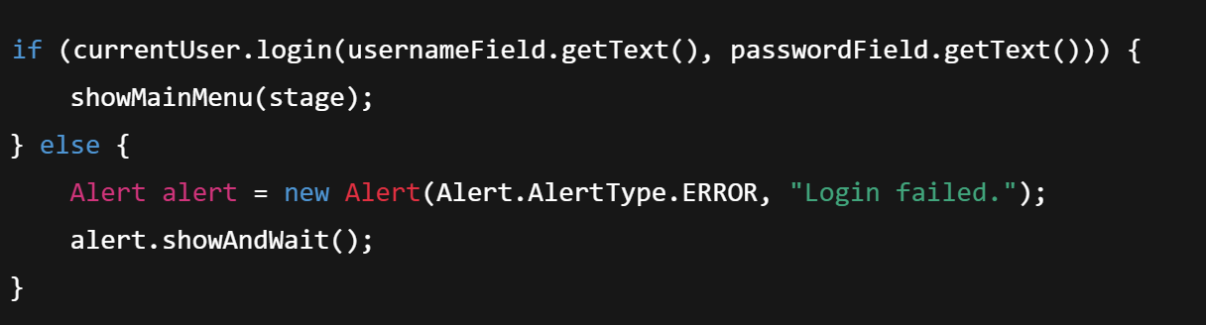
Conditionals and Loops
Concepts: if statements, loops
Here is the example of this in my source code:
Conditional logic in login
Used throughout dialogs for flow control

Slide 7

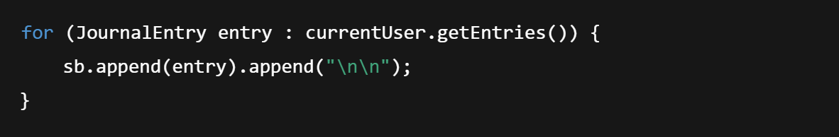
More Conditionals and Loops
We have more loop control, nested conditionals
Example
To explain this, looping over ArrayList to build view
Multiple checks for dialog results.

Slide 8

Object-Oriented Design
We learned about Encapsulation, responsibility, and modularity.
Design
User holds entries and reminders
JournalEntry, Reminder, and Tag each have clear roles
Diagram: Simple UML box diagram showing class relationships.

Slide 9

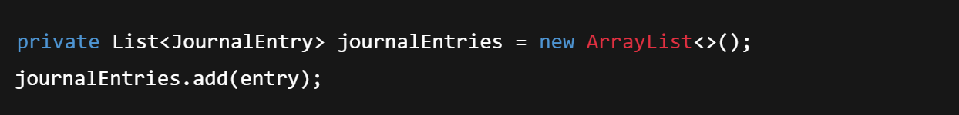
Array(ArrayLists)
Collections
Here is an example of this in my source code:
This use of ArrayList is for dynamic storage
Easy iteration and access to elements.

Slide 10

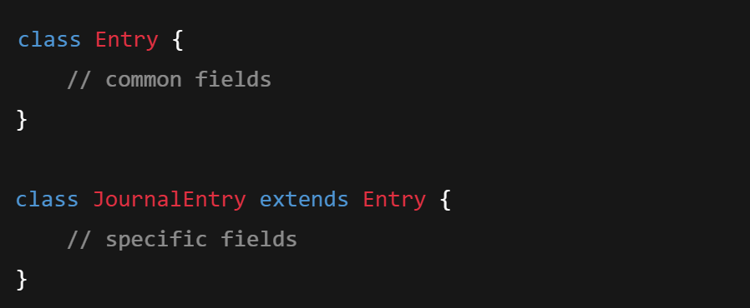
Inheritance
I tried to use inheritance for my project, but I did not like how it turned out
But if I were to use Inheritance one thing I can add is
I can use this class for the future to add to this project to make one big superclass.

Slide 11
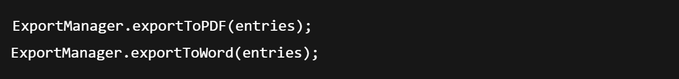
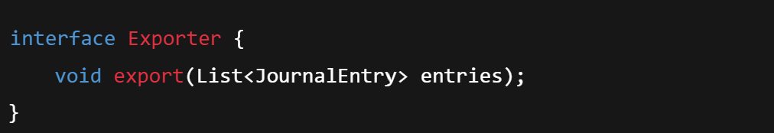
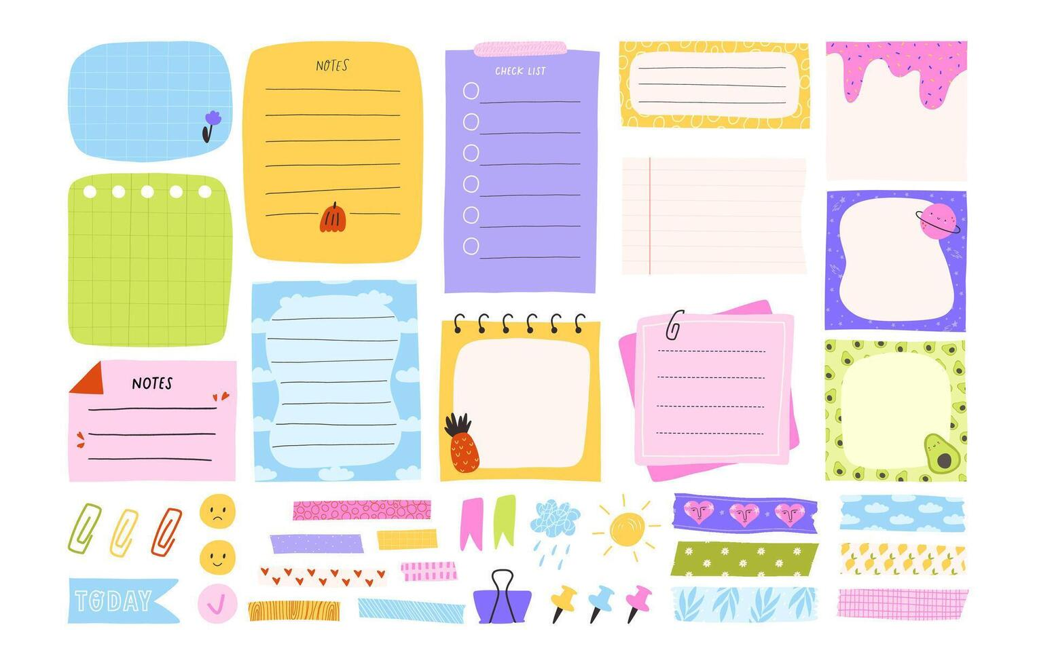
Polymorphism
This is used for method overriding, common interfaces
I have this used in my source code:
This is used to export my journal entries or convert them to PDF’S
One thing I can maybe add in the future is a way to export more than one entry at once for example:

Slide 12
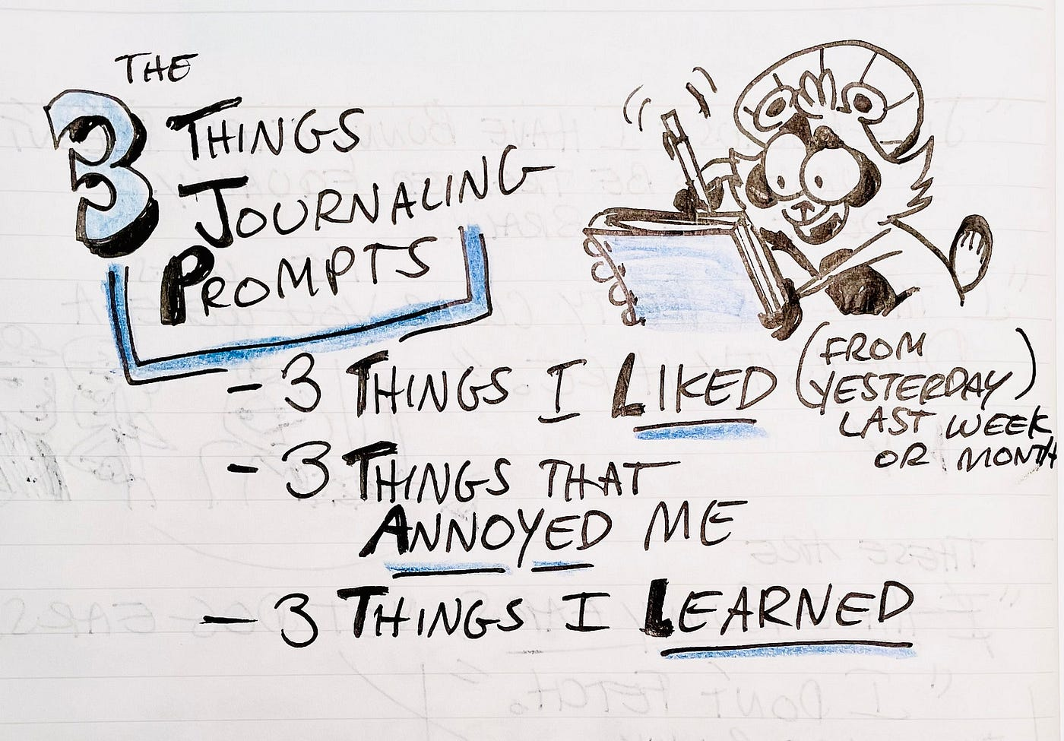
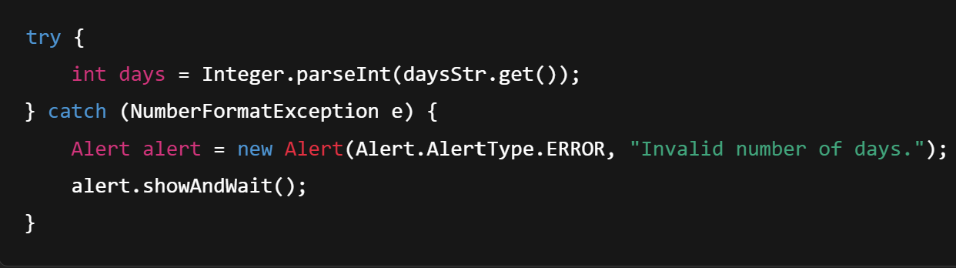
Exceptions
This is used to protect against bad user input
It also handles error without crashing the app

Slide 13

Time for a test run/ How it works
I will be showcasing
Login
Create Entry
View Entries
Set Reminder
Export(simulated in console)
It will show a clean OOP structure
Java FX for GUI and that it is extendable and modular

Slide 14

Challenges that I have faced
Designing class structures from scratch
Handling real-time input and dynamic data
Applying Object-Oriented Programming in a working application
Debugging logic and user input handling
Improved understanding of Java fundamentals and real-world app development
Allowed me to become more creative and make a big project of my own

Slide 15

Thank you so much listening
Does anyone have any questions, comments, or concerns?
Thank you so much for allowing me to share my creativity and present my project!
I hope that with this project I have inspired some of you to start your life with journaling!

